Slide 1


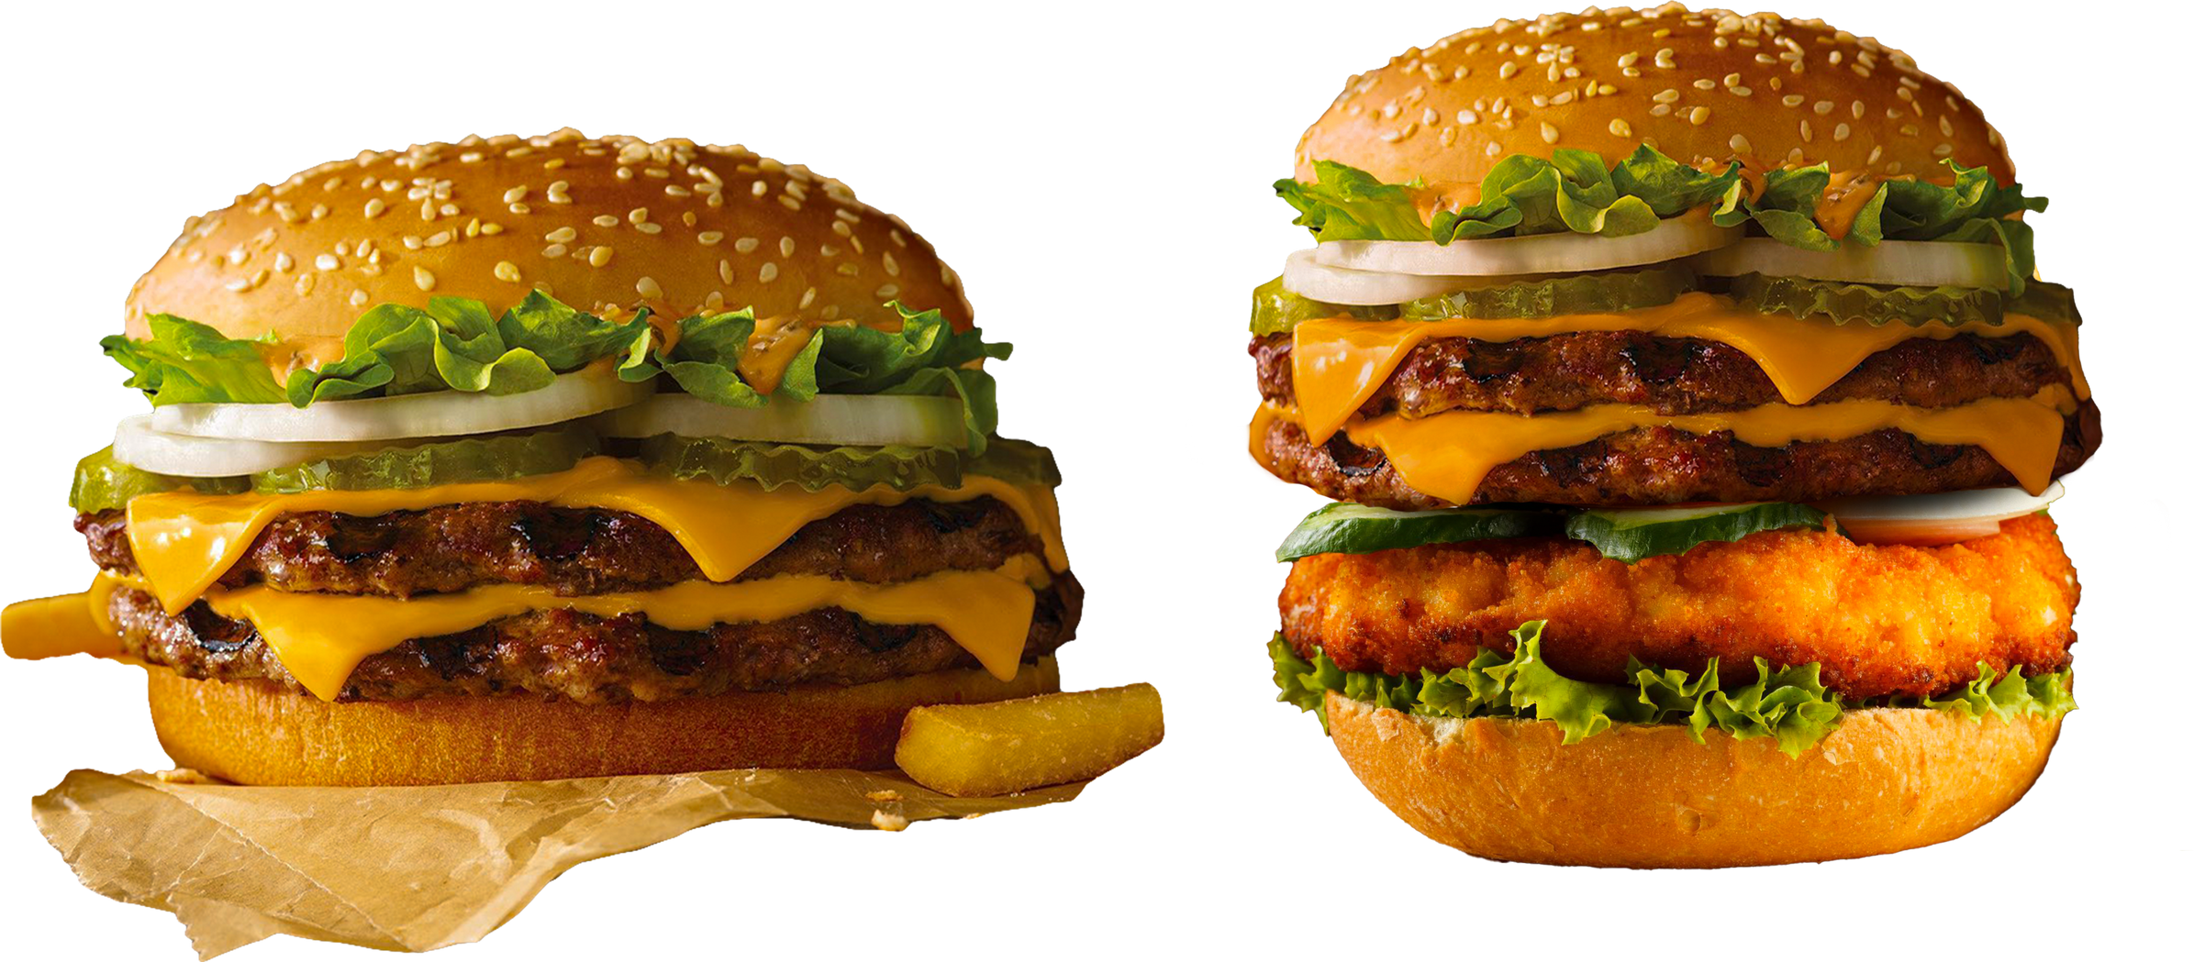
MCDONALD'S MENU NUTRITIONAL ANALYSIS PROJECT
PRESENTED BY MOHAMMAD ASAD

Slide 2
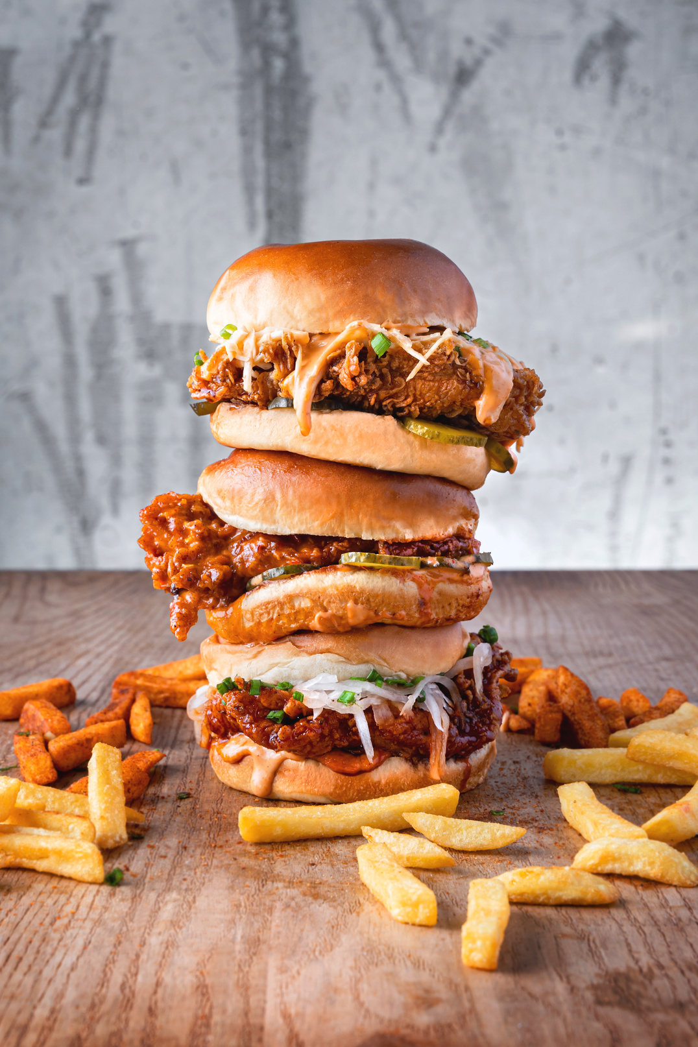

DESCRIPTION
This project wants to look at what's inside the food at McDonald's to help people make better choices when they order.
We'll check how much fat, sugar, and other stuff is in the food. This helps customers who want to eat healthier.
It also helps McDonald's because they can see which foods are really popular and which ones maybe need to change.
They can then make new foods that are better for everyone.

Slide 3
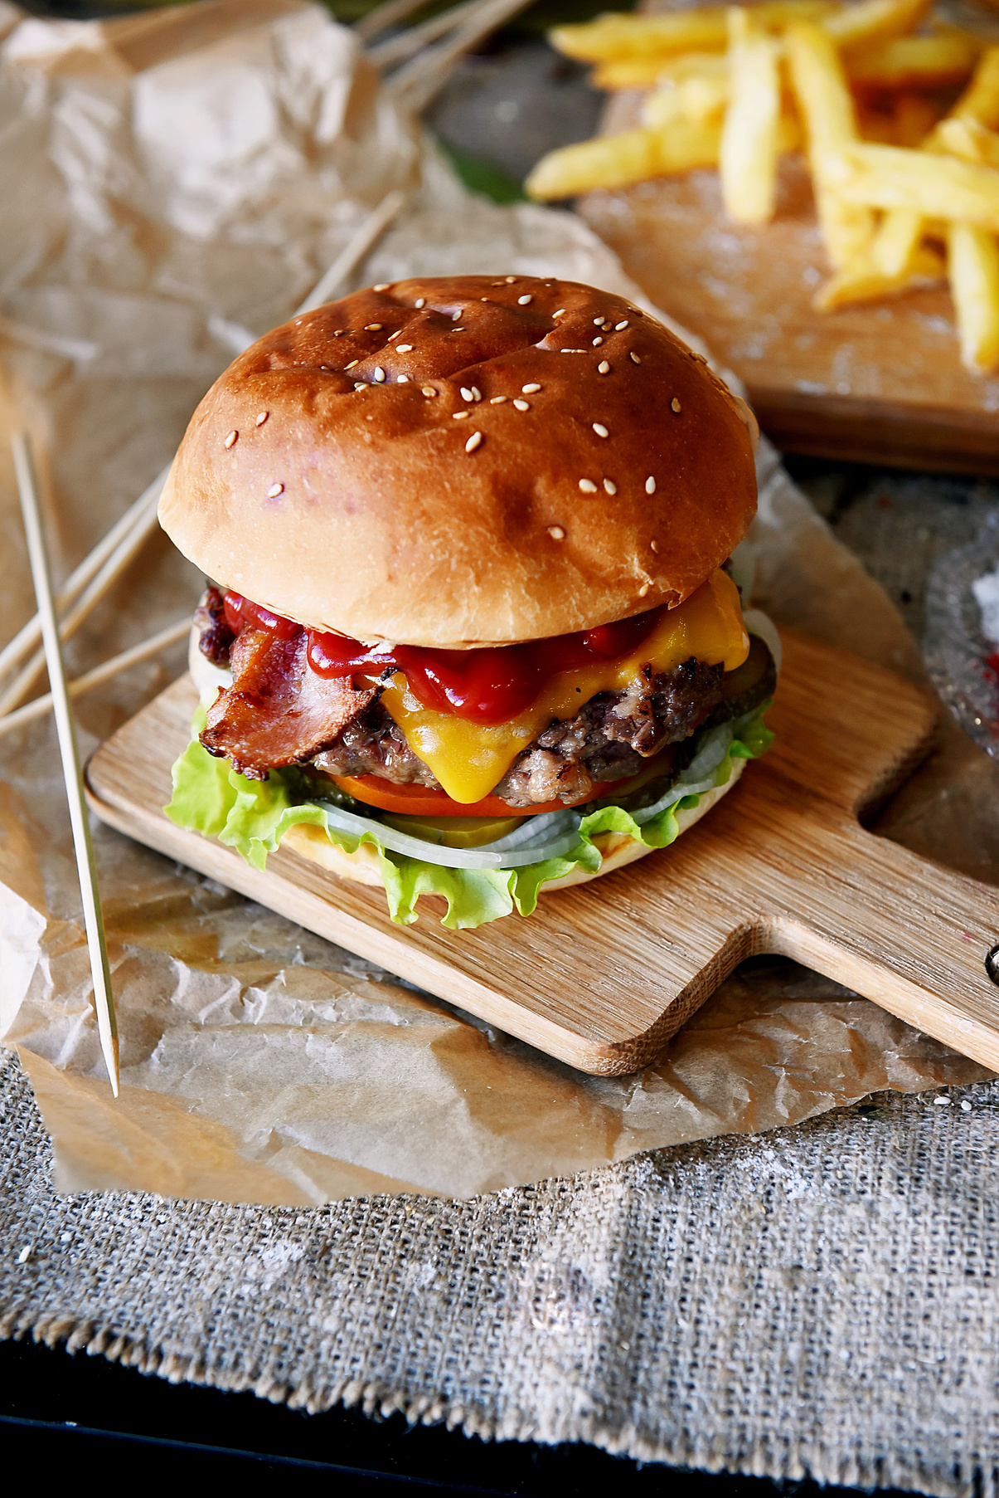

TOOLS AND TECHNOLOGIES USED
01
PPYTHON PROGRAMMING LANGUAGE
02
Anaconda Navigator
03
JUPYTER NOTEBOOK
04
SEABORN, PANDAS, MATPLOTLIB

Slide 4

PROBLEMS FACED
Understanding the basics of Nutritional facts
Understanding Data
Importing data
Exploratory data analysis using python language
Selection of charts for visualization

Slide 5
THANK YOU

